Slide 1

JAVA Programming Language
Basic Introduction

Slide 2
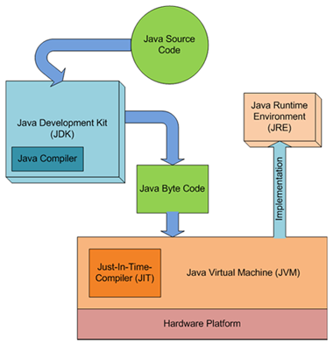
Introduction
JAVA is designed to be a platform-independent language, which means that code written in JAVA can run on any device or operating system that has a JAVA Virtual Machine (JVM) installed.

Slide 3
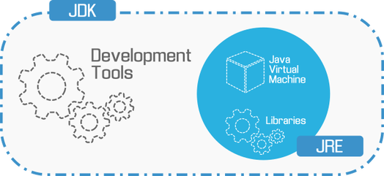
JDK stands for Java Development Kit, which is a software development kit used by developers to create JAVA applications. The JDK includes a set of programming tools, such as the JAVA compiler, debugger, and documentation, which are essential for developing JAVA applications.
JVM stands for Java Virtual Machine, which is the software that executes JAVA code. When a JAVA application is executed, the code is compiled by the JAVA compiler and converted into bytecode, which can be executed by the JVM. The JVM is responsible for interpreting the bytecode and executing the application on the underlying operating system.

Slide 4
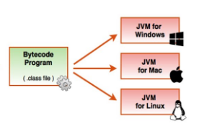

Steps to Create and run Java file
Install the Java Development Kit (JDK) on your computer. You can download the latest version of the JDK from the Oracle website.
Open a text editor like Notepad, Sublime Text, or Visual Studio Code.
Create a new file and save it with a .java extension. For example, you can name the file "Main.java"

Slide 5

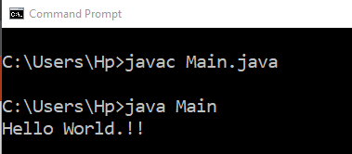
Example:
public class Main{
public static void main(String[] args){
System.out.println("Hello World.!!");
}
}
Commands:
Main.java
Main.class

Slide 6
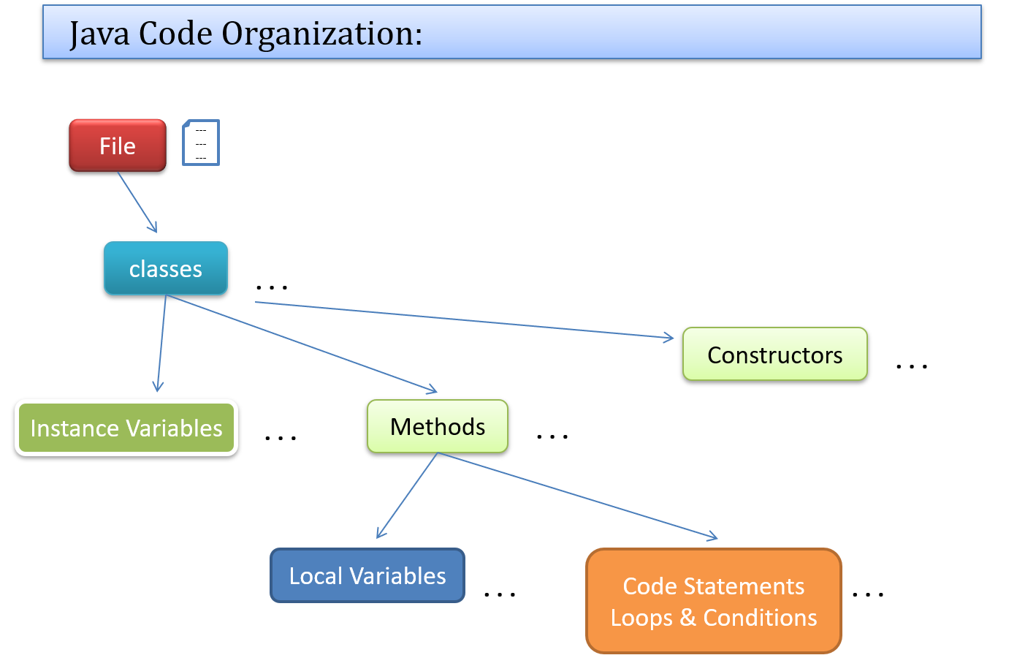

Slide 7
Primitive data types in Java
byte: This data type is used to store integer values between -128 and 127.
short: This data type is used to store integer values between -32,768 and 32,767.
int: This data type is used to store integer values between -2,147,483,648 and 2,147,483,647.
long: This data type is used to store integer values between -9,223,372,036,854,775,808 and 9,223,372,036,854,775,807.
float: This data type is used to store floating-point values with single precision.
double: This data type is used to store floating-point values with double precision.
boolean: This data type is used to store values that are either true or false.
char: This data type is used to store a single character or letter.

Slide 8
Example:
public class Main{
public static void main(String[] args){
byte b = 42;
Boolean flag = false;
Int x = 324584;
System.out.println(b); //output: 42
System.out.println(flag); // output: false
System.out.println(x); // output: 324584
}
}

Slide 9
Different ways to read input from Console
Using Scanner class:
The Scanner class provides a convenient way to read input from the console. You can use the Scanner class to read input from the console by creating a new Scanner object and then using the next or nextLine method to read the input.
Using BufferedReader class:
Another way to read input from the console is to use the BufferedReader class. This class provides a method called readLine() that reads a line of text from the console.
Using Console class:
If you are using Java 6 or later, you can use the Console class to read input from the console. This class provides methods like readLine() and readPassword() to read input.

Slide 10
Examples:
import java.util.Scanner;
public class ReadInput {
public static void main(String[] args) {
Scanner scanner = new Scanner(System.in);
System.out.print("Enter a string: ");
String str = scanner.nextLine();
System.out.println("You entered: " + str);
scanner.close();
}
}

Slide 11
Examples:
import java.io.BufferedReader;
import java.io.IOException;
import java.io.InputStreamReader;
public class ReadInput {
public static void main(String[] args) throws IOException {
BufferedReader reader = new BufferedReader(new InputStreamReader(System.in));
System.out.print("Enter a string: ");
String str = reader.readLine();
System.out.println("You entered: " + str);
reader.close();
}
}

Slide 12
File Reading and Writing
Using FileReader and FileWriter:
The FileReader and FileWriter classes provide a convenient way to read and write character data from/to a file. You can use these classes to read/write data one character at a time.
Using BufferedReader and BufferedWriter:
The BufferedReader and BufferedWriter classes provide a more efficient way to read and write data from/to a file. You can use these classes to read/write data in chunks.
Using FileInputStream and FileOutputStream:
The FileInputStream and FileOutputStream classes provide a way to read and write binary data from/to a file. You can use these classes to read/write data in bytes.

Slide 13
Example: File Reader and File Writer
import java.io.FileReader;
import java.io.FileWriter;
import java.io.IOException;
public class FileReadWrite {
public static void main(String[] args) throws IOException {
FileReader reader = null;
FileWriter writer = null;
try {
reader = new FileReader("input.txt");
writer = new FileWriter("output.txt");
int ch;
while ((ch = reader.read()) != -1) {
writer.write(ch);
}
}

Slide 14
finally {
if (reader != null) {
reader.close();
}
if (writer != null) {
writer.close();
}
}
}
}

Slide 15
Example: Buffered Reader and Buffered Writer
import java.io.*;
public class FileReadWrite {
public static void main(String[] args) throws IOException {
BufferedReader reader = null;
BufferedWriter writer = null;
try {
reader = new BufferedReader(new FileReader("input.txt"));
writer = new BufferedWriter(new FileWriter("output.txt"));
String line;
while ((line = reader.readLine()) != null) {
writer.write(line);
writer.newLine();
}
}

Slide 16
finally {
if (reader != null) {
reader.close();
}
if (writer != null) {
writer.close();
}
}
}
}

Slide 17
LinkedList Implementation
Define a class to represent the nodes of the linked list. Each node should have a data field to store the data and a reference field to point to the next node in the list.
Example:
class Node {
int data;
Node next;
public Node(int data) {
this.data = data;
this.next = null;
}
}
2) Create an instance of the Node class for each element of the linked list
Node head = new Node(1);

Slide 18
Example: create a Linkedlist of size 10 containing numbers from 1 to 10
class LinkedList{
public static void main(String[] args){
Node head = null,tail=null;
//create linked list of size 10 which contains numbers from 1 to 10
for(int i=1;i<=10;i++){
Node temp = new Node(i);
if(head==null){
head=tail=temp;
}else{
tail.next = temp;
tail = temp;
}
}

Slide 19
// print the linkedlist
print(head);
//output: 1 2 3 4 5 6 7 8 9 10
}
static void print(Node head){
while(head!=null){
System.out.print(head.data+" ");
head = head.next;
}
System.out.println();
}
}

Slide 20
Just like LinkedList we can also implement other data structure.
Stack
Queue
Deque
Java 10 API Documentation:
https://docs.oracle.com/javase/10/docs/api/index.html?overview-summary.html
Here you can check how different utility classes are implemented, like ArrayList, Stack, Queue(Interface), PriorityQueue, Deque etc.

Slide 21
array
One-dimensional array: A one-dimensional array is the simplest type of array, where the data elements are stored in a single row. It is also known as a vector or a list.
Example: dataType[] arrayName = new dataType[arraySize];
int[] numbers = new int[5];
Multidimensional array: A multidimensional array is an array that has more than one row and column. It is also known as a matrix or a table. In Java, you can create two-dimensional arrays, three-dimensional arrays, and so on.
Example: 2 D Array:
dataType[][] arrayName = new dataType[arraySize][arraySize];
int[][] numbers = new int[5][5];

Slide 22
Example
public class OneDArray{
public static void main(String[] args){
int[] arr = new int[5];
for(int i=0;i<5;i++){
arr[i] = i+1;
}
for(int i=0;i<5;i++){
System.out.print(arr[i]+" ");
}
}
}

Slide 23
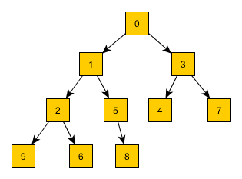
Heap (min or Max)
A heap is a data structure that is used to maintain a collection of elements with a specific ordering. A heap is a binary tree where each node has a value that is greater than or equal to (for a max heap) or less than or equal to (for a min heap) the values of its child nodes.
A heap is commonly used to implement priority queues, where the elements are sorted by their priority.
Min Heap

Slide 24
class MinHeap{
static void heapify(int[] arr,int i,int n){
int idx = i,l = 2*i+1,r = l+1;
if(l<n && arr[l]<arr[idx]){
idx = l;
}
if(r<n && arr[r]<arr[idx]){
idx = r;
}
if(i!=idx){
int t = arr[idx];
arr[idx] = arr[i];
arr[i] = t;
heapify(arr,idx,n);
}
}

Slide 25
static void buildHeap(int[] arr,int n){
for(int i=n/2-1;i>=0;i--){
heapify(arr,i,n);
}
}
public static void main(String[] args){
int[] arr = {10,4,15,1,5,8,2};
int n = arr.length;
buildHeap(arr,n);
for(int i=0;i<n;i++){
System.out.print(arr[i]+" ");
}
}
}

Slide 26
Thank you

